Slide 1
Missing data and multiple imputation in clinical epidemiological research.
(Clinical epidemiology)
Authors:
Alma B Pedersen
Ellen M Mikkelsen
Deirdre Cronin-Fenton
Nickolaj R Kristensen
Tra My Pham
Lars Pedersen
Irene Petersen
Ishita Deodhar (21060641020)
Sayali Bora (21060641045)

Slide 2
Contents
Objectives
Introduction
Types of missing data
Methods to minimize missing data in the design phase
Methods of dealing with missing data in the analytic phase
Comparison of multiple imputation with complete case analysis
Conclusion

Slide 3
Objectives
To describe methods often used for dealing with missing data in the analytical phase and highlight their shortfalls.
To introduce multiple imputation as an alternative method, highlighting its advantages over “traditional” methods.
To discuss reporting of the results from multiple imputation analyses.

Slide 4
Introduction
Despite implementation of standardized data collection forms, missing data are ubiquitous in clinical epidemiological research.
Missing data can occur for multiple reasons –loss to follow-up, failure to attend medical appointments, lack of measurements, failure to send or retrieve questionnaires, and inaccurate transfer of data from paper registration to an electronic database.
Individuals with missing data may differ from those with complete data in terms of the outcome of interest and prognosis in general.
Missing data can constitute considerable challenges in the analyses and interpretation of results and potentially weaken the validity of results and conclusions.
Missing data are problematic because of the risk of bias, which depends on the type of missing data, the extent of the data that are missing, and the way of dealing with missing data in the analyses.

Slide 5

Types of missing data
When individuals with missing data are a random subset of the study population, the probability of being missing is the same for all cases; missing data are denoted as MCAR.
In contrast to MCAR, MAR occurs when the missingness depends on information we have already observed.
When the probability that data are missing depends on the unobserved data, such as the value of the observation itself, then the missing data are denoted as MNAR.

Slide 6
Methods to minimize missing data in the design phase
It may be helpful to incorporate standardized rules to optimize data collection, such as training staff to collect and coordinate data collection, using well-defined data definitions, and incorporating logic and range checks for each data element.
Pilot studies can help to identify variables particularly susceptible to missing values, and steps can be taken to improve completeness.
Regular monitoring of data quality and completeness provides essential feedback to researchers on the extent of missing data.
Furthermore, when collecting information about the quality of life or other sensitive issues, patients may be asked to provide reasons for refusing to participate, such as a lack of time, problems understanding language, or lengthy or too intimate questionnaires.
This information can be used in the analyses of data and interpretation of the results.

Slide 7
Methods of dealing with missing data in the analytic phase
Several statistical approaches have been developed for dealing with missing data.
The most common methods can be classified into one of the following groups:
complete-case analyses
missing indicator method
single value imputation
sensitivity analyses incorporating worst-case and best-case scenarios.
An alternative method of dealing with missing data in the analytic phase is multiple imputation.

Slide 8
Method | Description | Assumption to achieve unbiased estimates | Advantages | Limitations
Complete-case analysis | Include only individuals with complete information on all variables in the dataset. | MCAR | Simplicity Comparability across analyses | Data may not be representative. Reduction of sample size and thereby of statistical power. Too large standard error. Discarding valuable data.

Slide 9
Method | Description | Assumption to achieve unbiased estimates | Advantages | Limitations
Missing indicator method | For categorical variables, missing values are grouped into a “missing” category. For continuous variables, missing values are set to a fixed value (usually zero), and an extra indicator or dummy (1/0) variable is added. | None | Uses all available information about missing observation and retains the full dataset. | The magnitude and direction of bias is difficult to predict Too small standard error The results may be meaningless since method is not theoretically driven.

Slide 10
Method | Description | Assumption to achieve unbiased estimates | Advantages | Limitations
Single value imputation | Replace missing values by a single value (e.g., mean score of the observed values or the most recently observed value for a given variable if data are measured longitudinally) | MCAR, only when estimating mean | Run analyses as if data are complete Retains full dataset | Too small standard error Potentially biased results Weakens covariance and correlation estimates in the data (ignores relationship between variables)

Slide 11
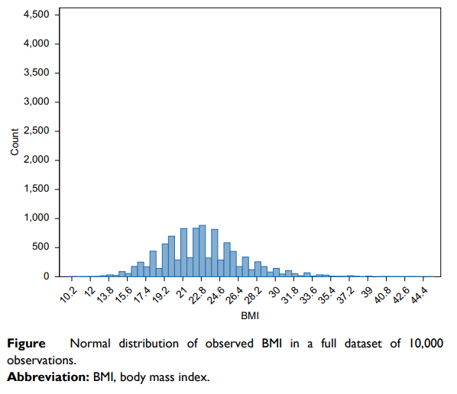
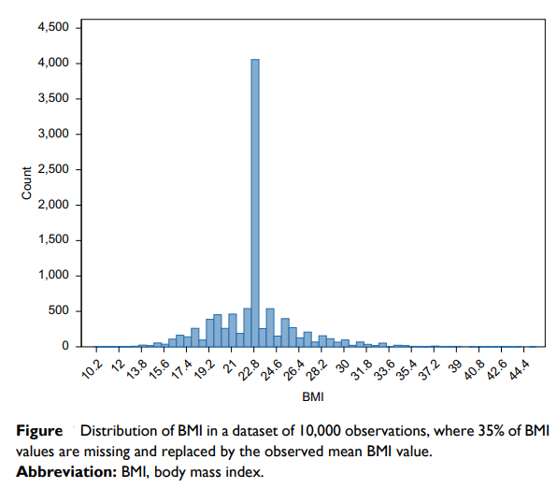

Slide 12
Method | Description | Assumption to achieve unbiased estimates | Advantages | Limitations
Sensitivity analyses with worst- and best-case scenarios | Missing data values are replaced with the highest or lowest value observed in the dataset | MCAR | Simplicity Retains full dataset | Too small standard error and thereby overestimation of precision of the results. Analyses yielding opposite results may be difficult to interpret

Slide 13
Method | Description | Assumption to achieve unbiased estimates | Advantages | Limitations
Multiple imputation | Missing data values are imputed based on the distribution of other variables in the dataset | MAR (but can handle both MCAR and MNAR) | Variability more accurate for each missing value since it considers variability due to sampling and due to imputation (standard error close to that of having full dataset with true values) | Room for error when specifying models

Slide 14
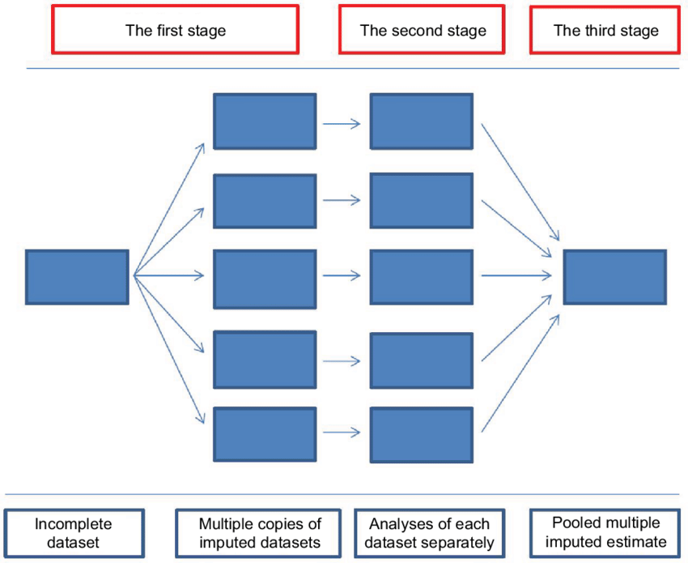
Stages to implement multiple imputation

Slide 15
How many imputed datasets?
Traditionally, it has been suggested that three to five imputed datasets are sufficient.
The argument was that even with 50% missing information, five imputed data sets would produce point estimates that are 91% as efficient as those based on an infinite number of imputations.
However, Graham et al showed that the statistical power and precision of estimates can be improved by creating many more imputed datasets depending on the amount of missing information and the tolerance for the loss of power.
Later, Bodner and White suggested the rule of thumb in order to increase a level of reproducibility of the results in practice; the number of imputations should be similar to the percentage of incomplete cases.
Buuren suggested a compromise solution, using five imputations for model building in the initial phase and increasing the number of imputations to the average percentage of missing data in the final phase of the analyses.

Slide 16
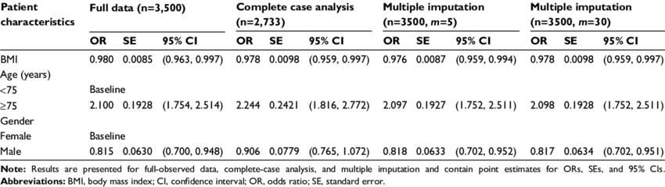
Multiple imputation example

Slide 17
Conclusion
This paper provides insights on the type of missing data, traditional methods, and multiple imputation as alternative methods to deal with missing data, including their shortfalls and advantages.
For the most part, in clinical epidemiologic research, missing values are neither MCAR nor MNAR but MAR. Missing data can constitute considerable challenges in the analyses and interpretation of results and can potentially weaken the validity of results and conclusion.
Several methods have been developed for dealing with missing data including complete-case analyses, missing indicator method, single value imputation, and sensitivity analyses incorporating worst- and best-case scenarios.
In addition, these methods are characterized by too large standard errors due to the lack of precision of the results or by too small standard errors due to the overestimation of the precision of results.
Multiple imputation is an advanced method to deal with missing data.
Multiple imputation provides unbiased and valid estimates of associations based on information from the available data.

Slide 18
References
Missing data and multiple imputation in clinical epidemiological research.(2017)
Link : https://www.dovepress.com/missing-data-and-multiple-imputation-in-clinical-epidemiological-resea-peer-reviewed-fulltext-article-CLEP
Flexible Imputation of Missing Data by Stef Van Buuren.
Book link : http://pzs.dstu.dp.ua/DataMining/preprocessing/bibl/fimd.pdf

Slide 19
THANK YOU !

